Slide 1

Student Grade Tracker
Salem State University
Computer Science Department
CSC 279 C+C++
Fall 2019
Team Members:
Nicholas Alpine
Tristan Casey
Aman Rauniyar

Slide 2
Outline
Introduction
Methodology
UML Diagrams
Input
Results
Challenges
Conclusion
Future Work
References

Slide 3
Introduction
The goal of our project was to make a grade-tracking program using the C/C++ programming language. Some of the ideas we have included or would like to include later are:
Allowing the user to input grades for students.
Storing a student’s grade using a database.
Automatically having the program calculate each student’s GPA based on the information entered by the user.
Output reports that display certain personal information about the student (such as their full name, age, education level, etc.) and relevant grade information (grade for each class using both percent and letter scores, their current GPA, etc.).

Slide 4
Methodology
Structure
Course
Classes:
Main Class
Student Class
Functions:
Example
printAllCourses
printCourse
findCourse
addCourse
removeCourse

Slide 5
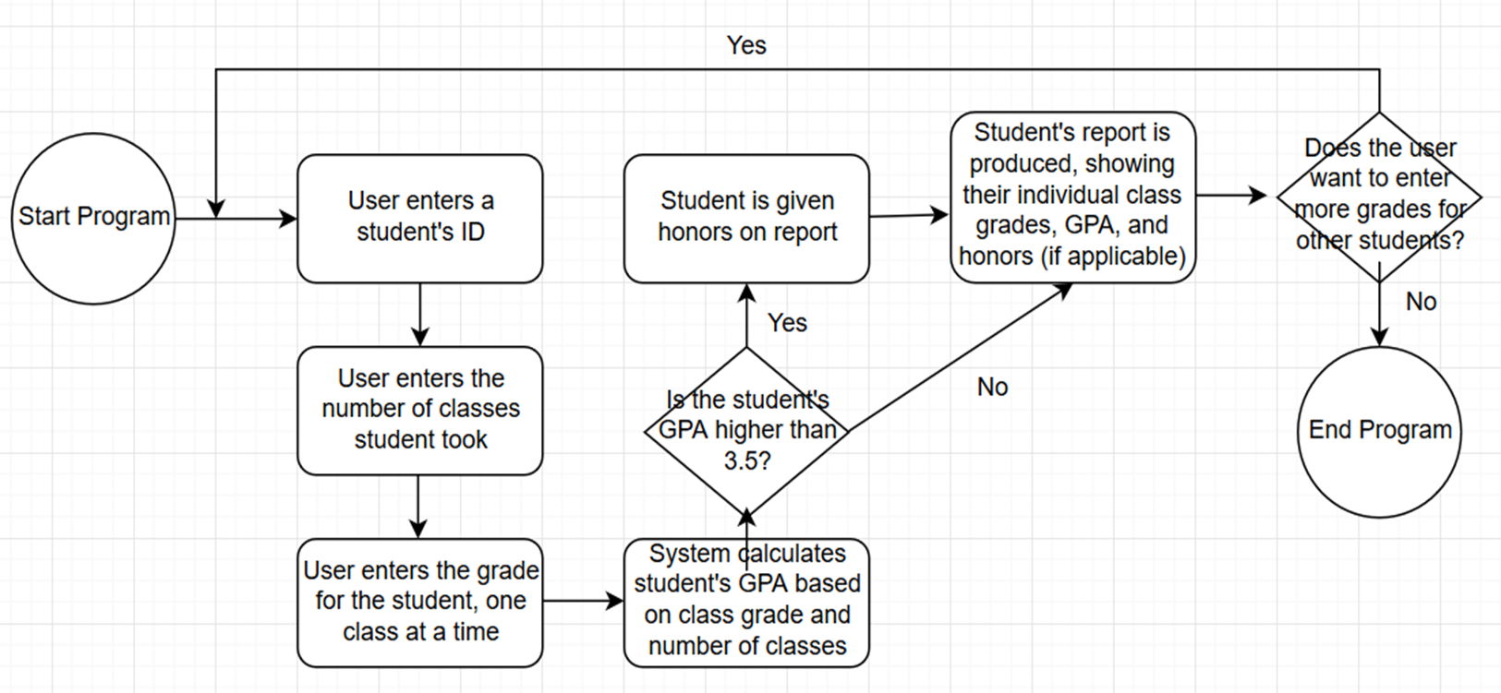
UML Diagram

Slide 6
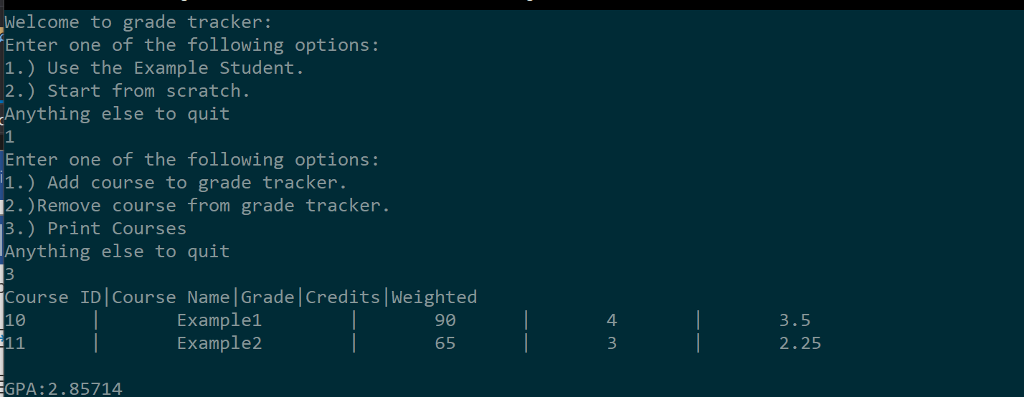
Input
Running the Example Student to show how data input into the program will be displayed:

Slide 7
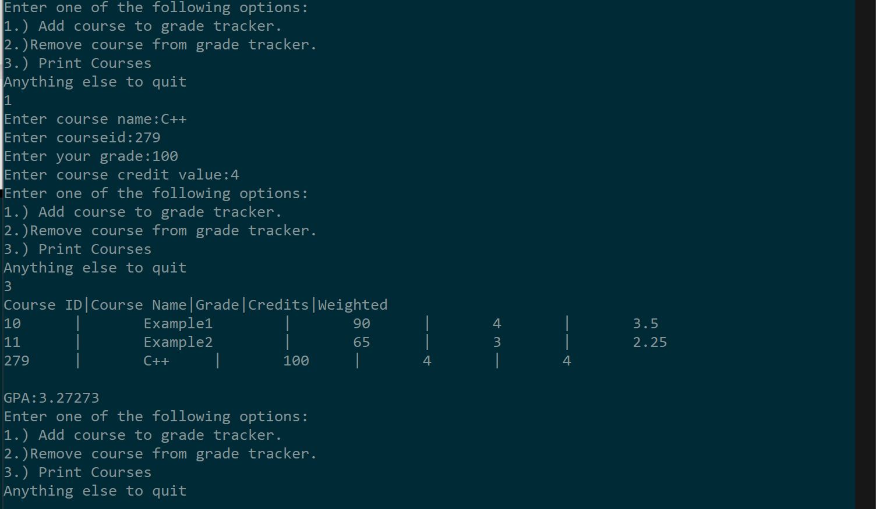
Results
Adding a new course and printing out information on every course in the grade tracker:

Slide 8
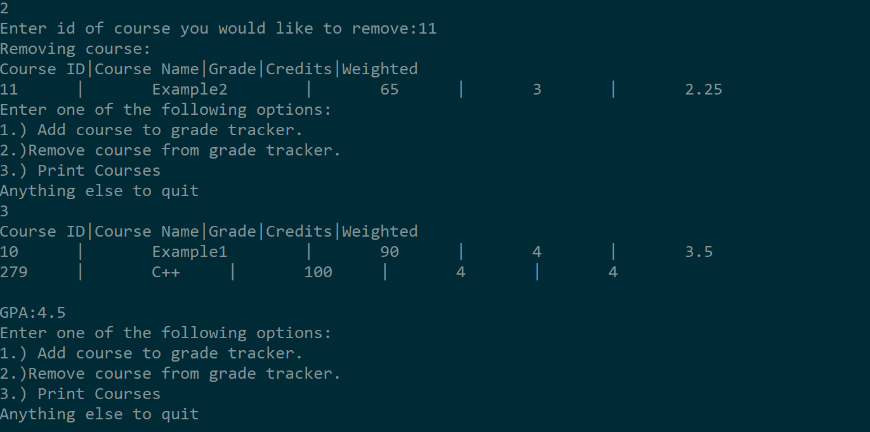
Results
Removing an existing course and printing out information for the new course list in the grade tracker:

Slide 9
Challenges
Some of the challenges faced while working on this project include:
Using a vector to store courses instead of a map.
Deciding if the function for calculating GPA should be in the Student class or its own GPA class.

Slide 10
Conclusion
The number of students attending schools are increasing, so it’s important for every student to be able to know which courses they have taken and what grades they have so they can plan ahead.

Slide 11
Future Work
Some possible features that could be implemented in the future:
The ability to track the grades of multiple students at once.
The ability for students to choose courses from a list and add them to the grade tracker.
The ability to save and load student data to a file instead of being deleted after the program closes.

Slide 12
References
https://github.com/ (for sharing the code between team members)
https://stackoverflow.com/ (for help on proper syntax in certain parts of the project)

